Slide 1
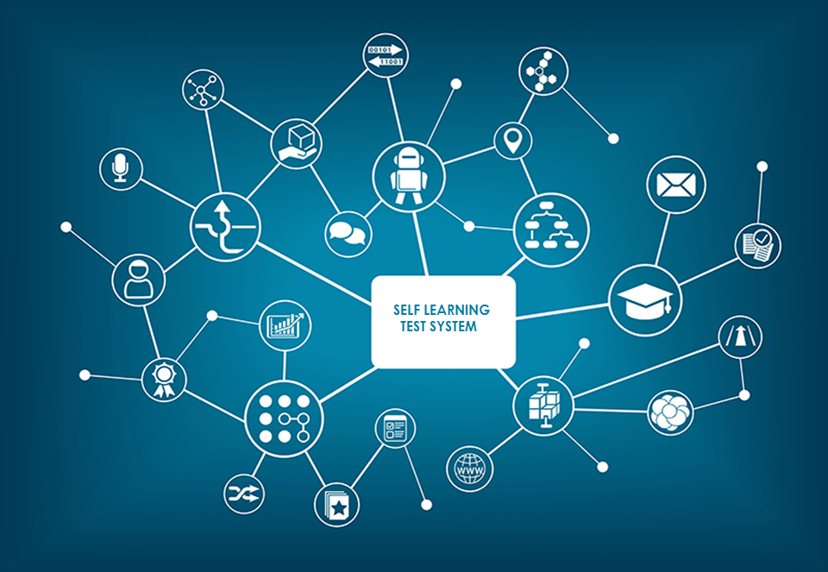

Slide 2
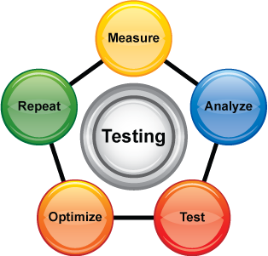
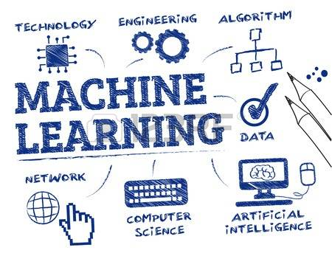
ABSTRACT
With the adoption of Agile process in software development, time to market has improved drastically. In order to ensure the quality of deliverables, we need to upgrade our Test Strategy iteratively.
This presentation gives an insight as to how Test strategy can be strengthened by incorporating
Machine Learning concepts and Algorithms into Software Testing.

Slide 3
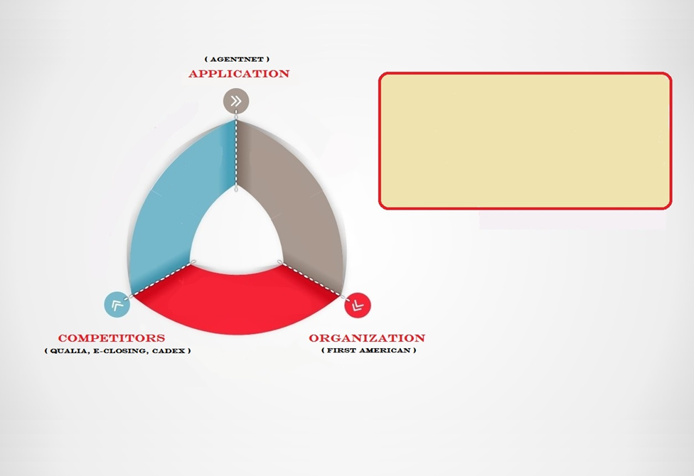
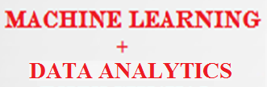


Slide 4
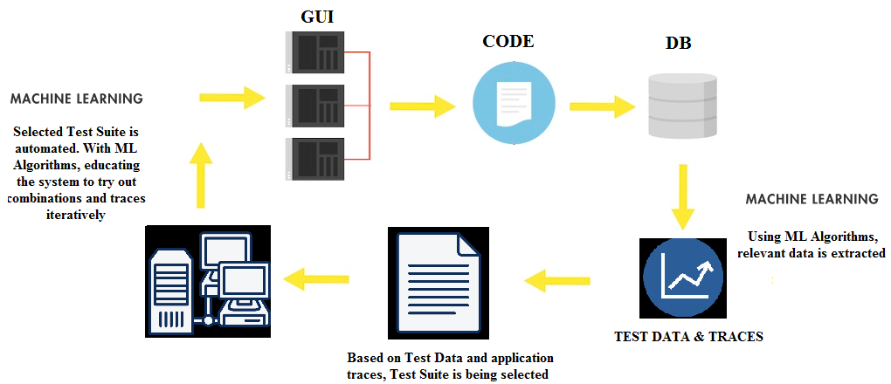
APPROACH

Slide 5

REGRESSION TESTING
Find out User traces in the application
Apply machine learning algorithm
Obtain best possible flows traversed by real time agents
Traces are categorized
Trace 1 | BOPS, Jacket, R&F
Trace 2 | SDN, CPL, R&F
Trace 3 | CPL, Jacket, R&F

Slide 6
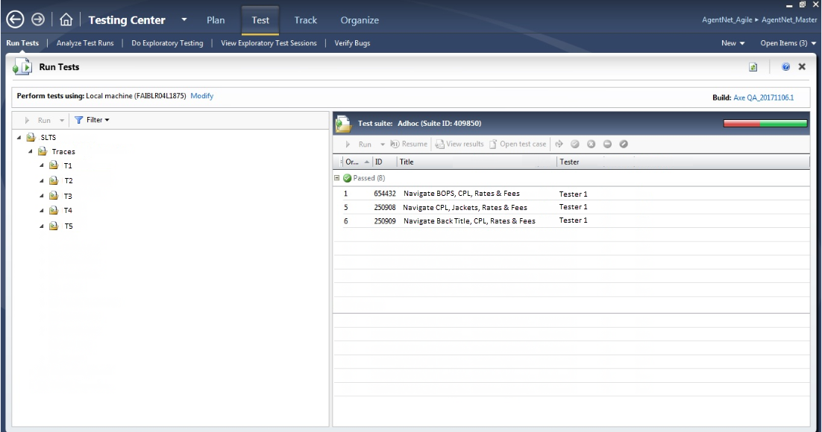

Slide 7
RECOMMENDATIONS

Slide 8
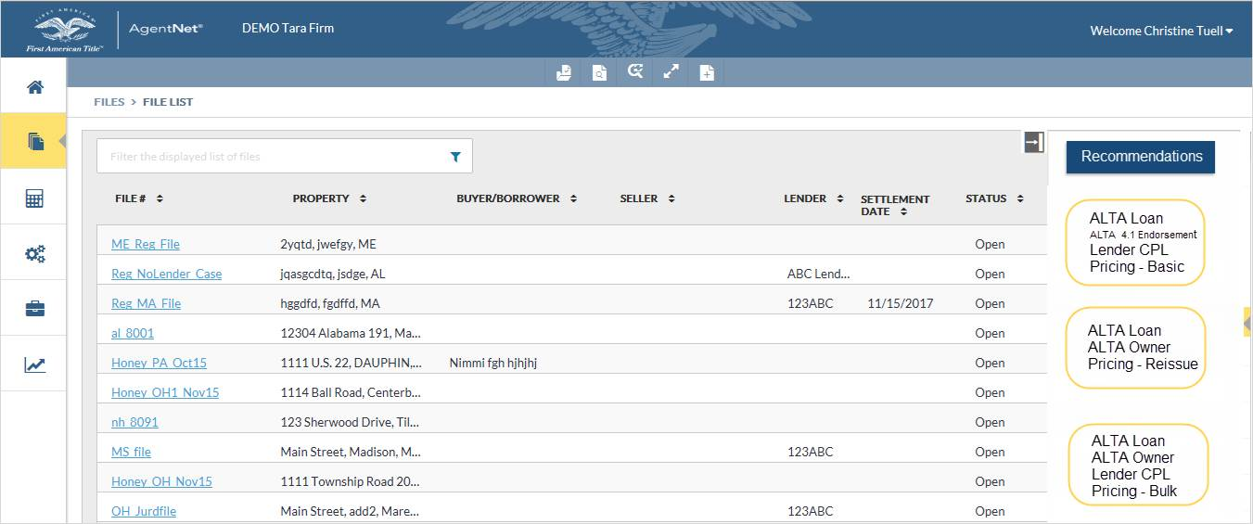

Slide 9
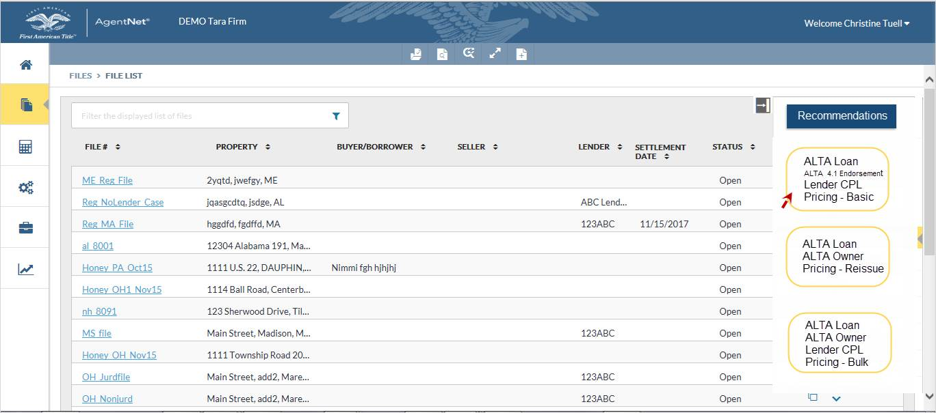

Slide 10
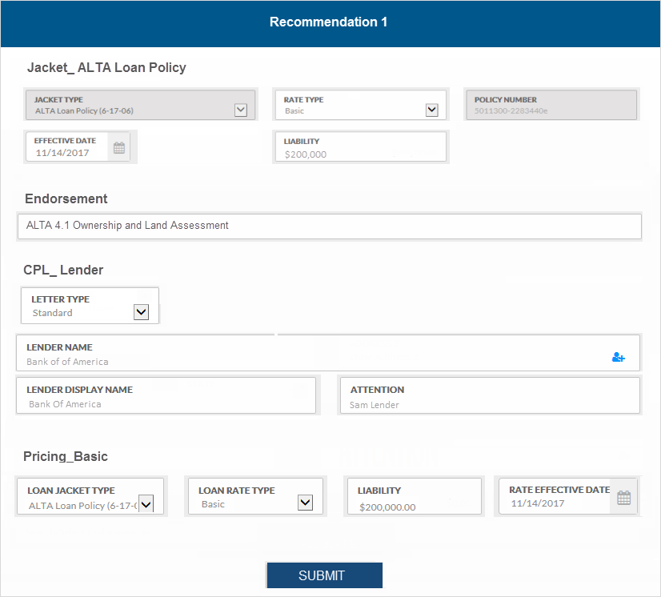

Slide 11
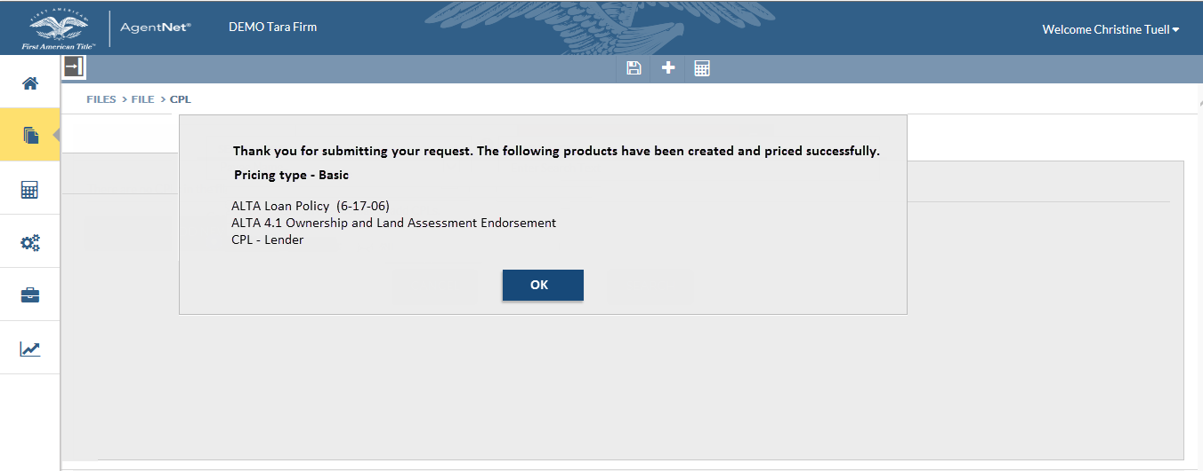

Slide 12

ERROR DETECTION
Find out the frequency of occurrence of error types
and their origin
Obtain error data from the real time log files
logviewplus_setup_1.2.19.exe
Beneficial in identifying the roadblocks in application
Enhance the Dev & QA processes from organizational perspective
and also aids in customer training sessions
12

Slide 13
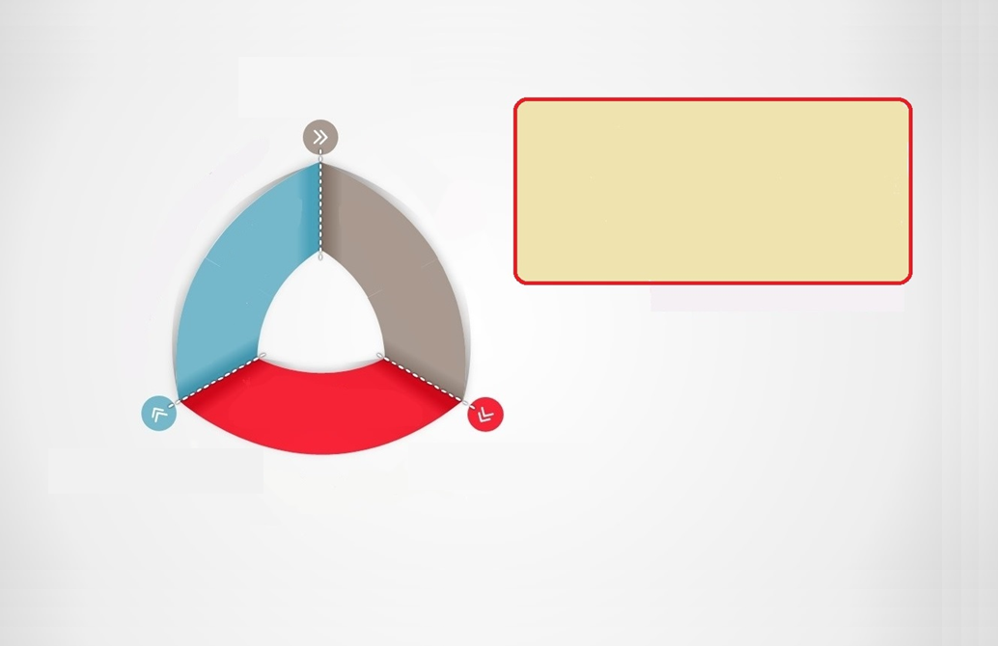


QUALITY
VALUE INNOVATION
RETURN ON INVESTMENT

Slide 14
QUALITY
Determine the intensity of modular testing required
Test transition from QA perspective to more of Agent perspective
Efficient utilization of time and team strength

Slide 15
VALUE INNOVATION
Enhance User experience based on preferences/market trends
Enhance the turn around time
Capture the market via continuous interaction
Example: Titan
Provide relevant feedback on our business requirements

Slide 16
RETURN ON INVESTMENT
 | Conventional Process [Effort] | Proposed Process [Effort] | Increment in Efficiency
QUALITY | 8D * 5M * 6H = 240 MH | 4D * 4M * 6H = 96 MH | 150%
TURN AROUND TIME | 8T / Day 1T = 1 H | 16T / Day 1T = 0.5 H | 100%

Slide 17
Thank You!!!

